Slide 1
For Live Session
Unit 6

Slide 2
For Live Session: Part 1 (3-5 hours)
Download the training set: Connect to the opendatasoft website and download the random sample of 891 Titanic Passengers. This is the training set. The data come in JSON form format and you can use this URL to access the data:
https://public.opendatasoft.com/api/records/1.0/search/?dataset=titanic-passengers&rows=2000&facet=survived&facet=pclass&facet=sex&facet=age&facet=embarked
Hint: This is not trivial. I recommend that you use the jsonlite package (fromJSON()) and RCurl package (getURL()) to access the data. (We covered this in Unit 4).
Try your best to access the data using the URL. You may also find the data (titanic_train.csv) on github. We will go over this data ingestion in live session.
Use KNN to classify those who survived and died based on Age and class.
Use your age and predict your survival based on each of the ticket classes.
Use your model to classify the 418 randomly selected passengers in the test set (titanic_test.csv) on github.
Create a confusion matrix and calculate the accuracy, misclassification rate, sensitivity and specificity. Be prepared to explain these statistics. (It is ok if you have questions here… we will answer them in live session … just do your best in the time allotted.)
Make a PowerPoint to present in Live Session
BONUS: Create separate models for males and females and compare the resulting classification statistics after using the models to classify those in the test set.

Slide 3
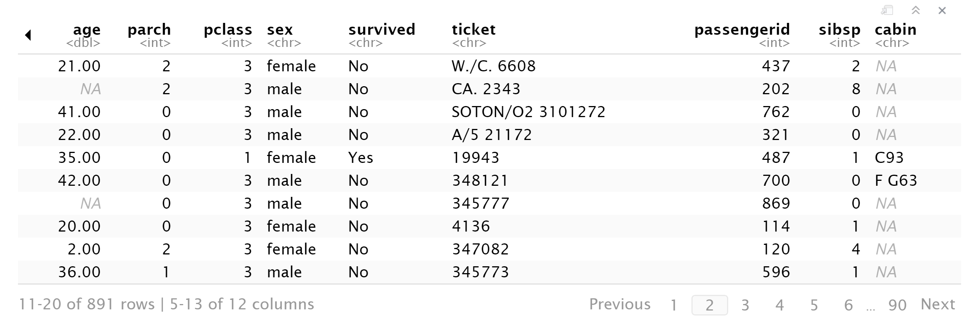

Slide 4
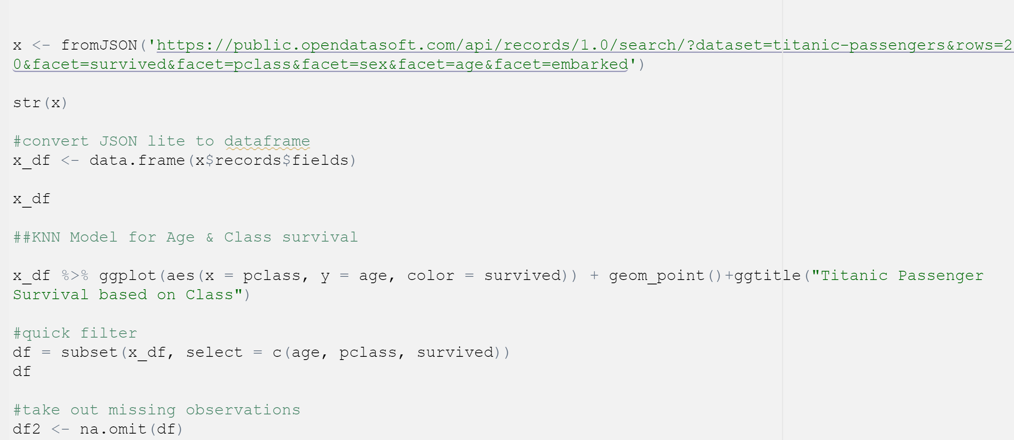
Code for loading & cleaning data

Slide 5
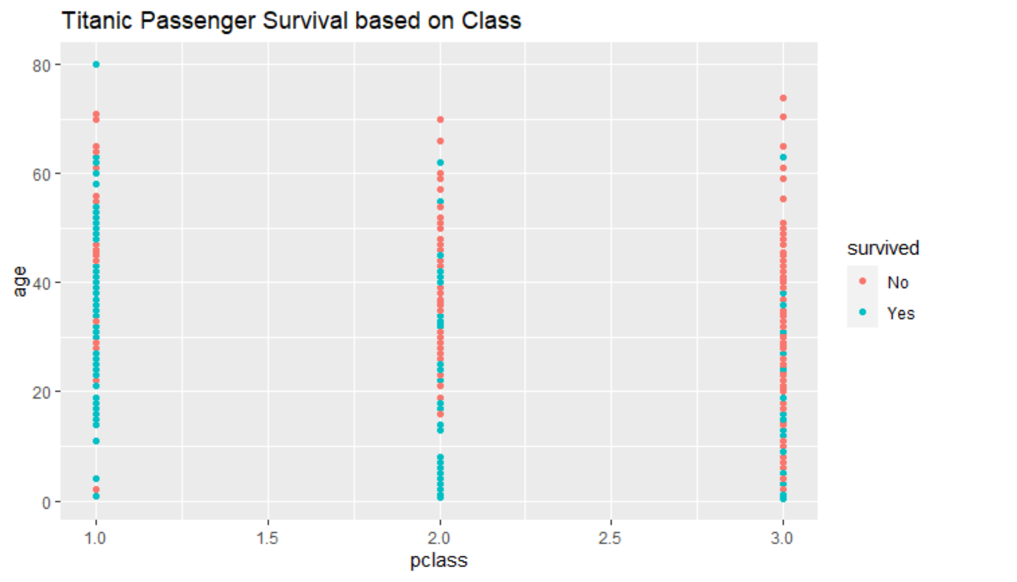

Slide 6
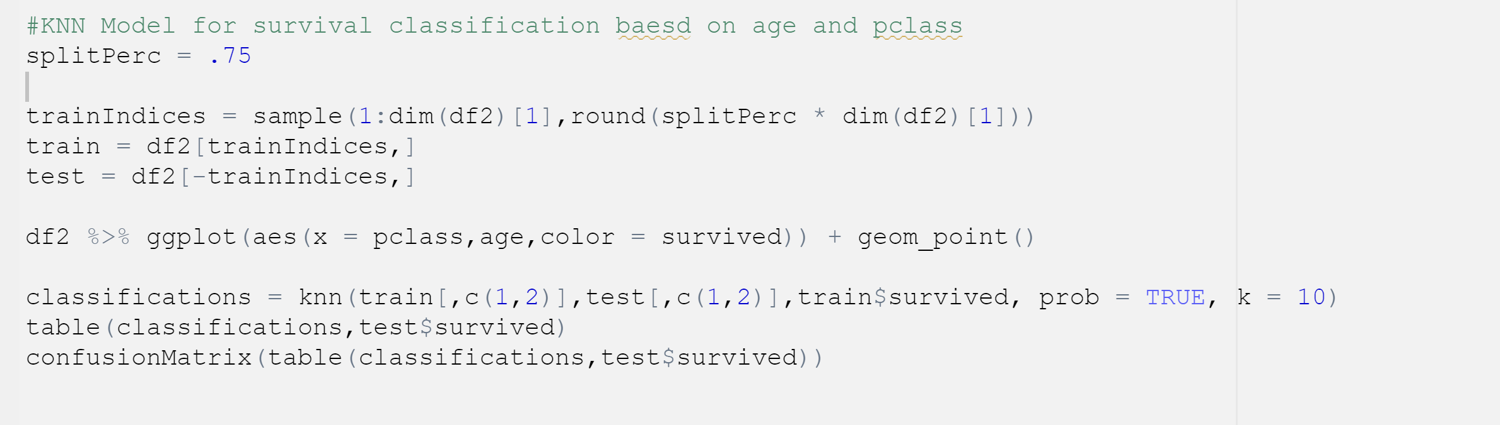
ML code

Slide 7
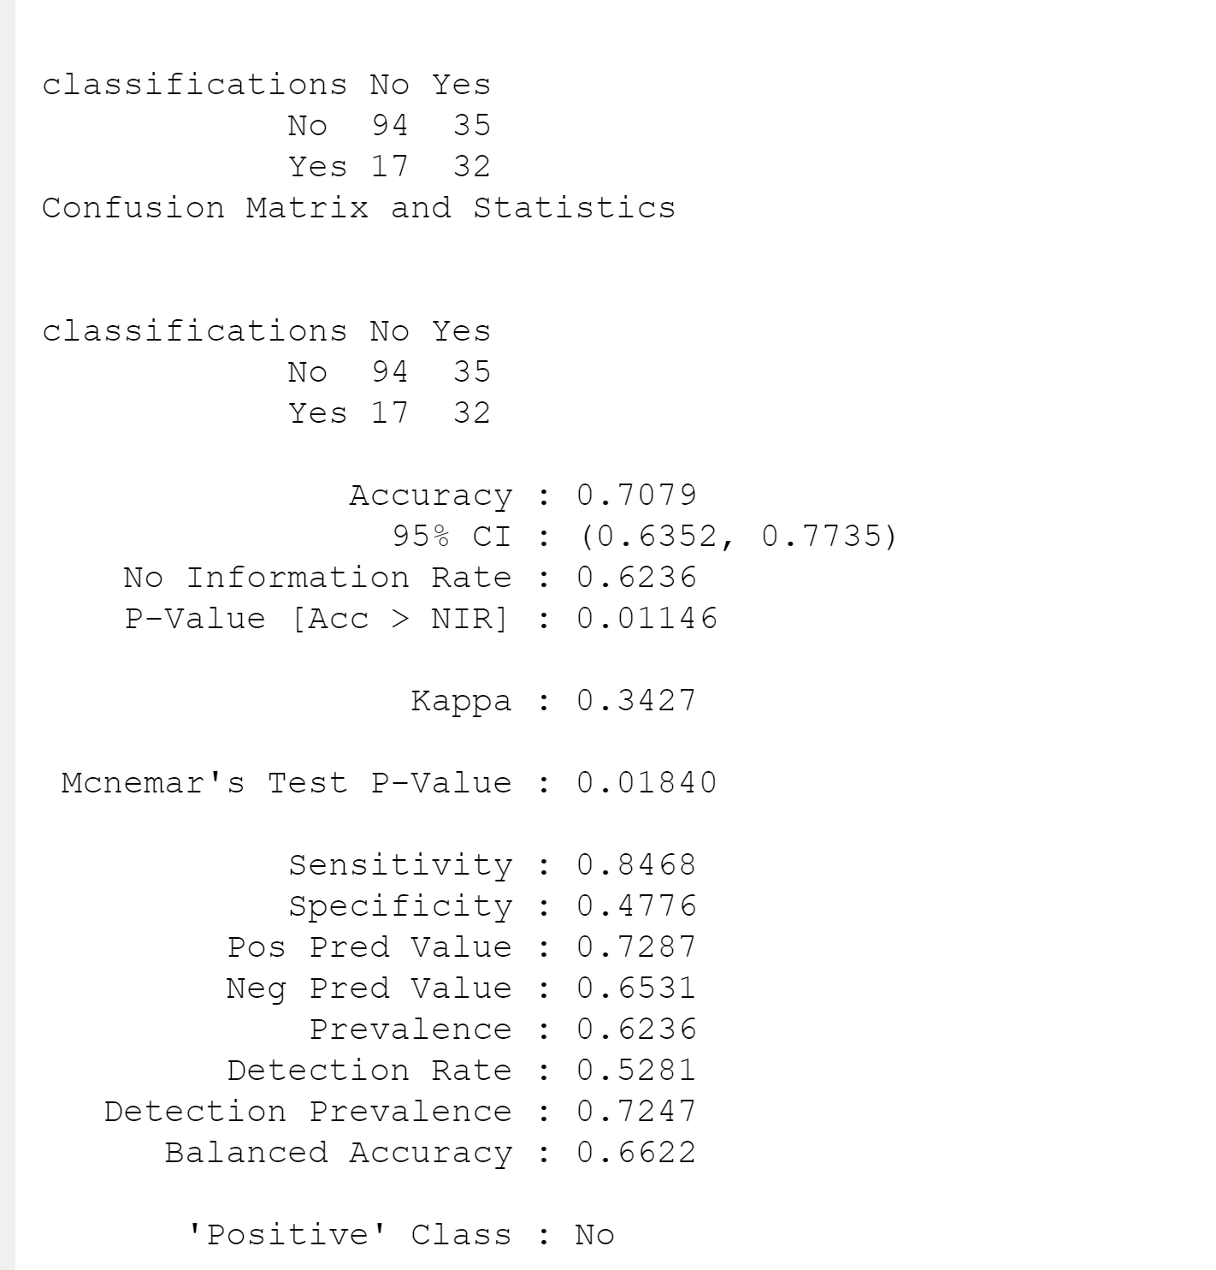
KNN model with K=10

Slide 8
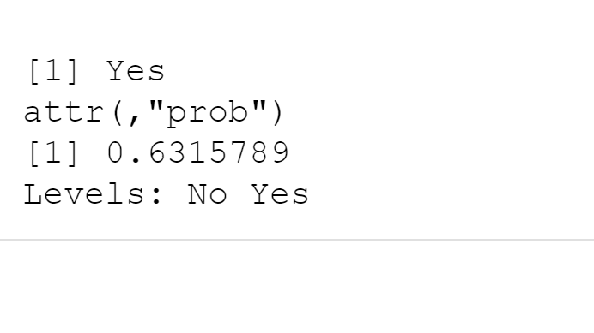
Age 33 Pclass = 1

Slide 9
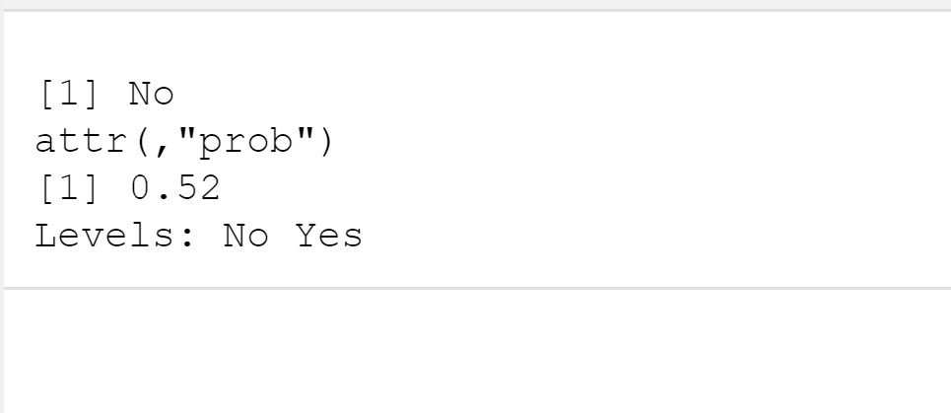
Age 33 Pclass = 2

Slide 10
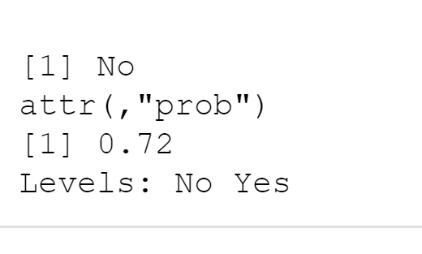
Age 33 Pclass = 3

Slide 11
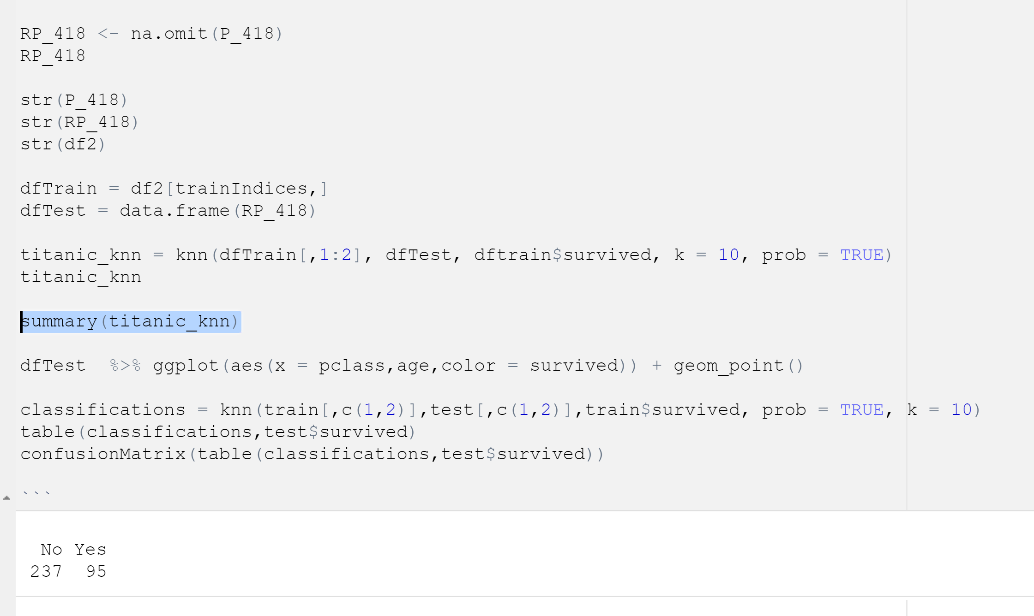
Results of 418 passengers

Slide 12
For Live Session: Part 2 (3 – 4 hours)
a. For the full (multinomial) IRIS data (the iris dataset in R), do a 70-30 train/test cross validation with k =1 - 90 and use sepal length and width as predictors. Make a plot of k (xaxis) versus accuracy. Use this plot to tune the hyperparameter k. What do you feel is the best value of k?
BONUS: Repeat the above analysis with a leave one out cross-validation.

Slide 13
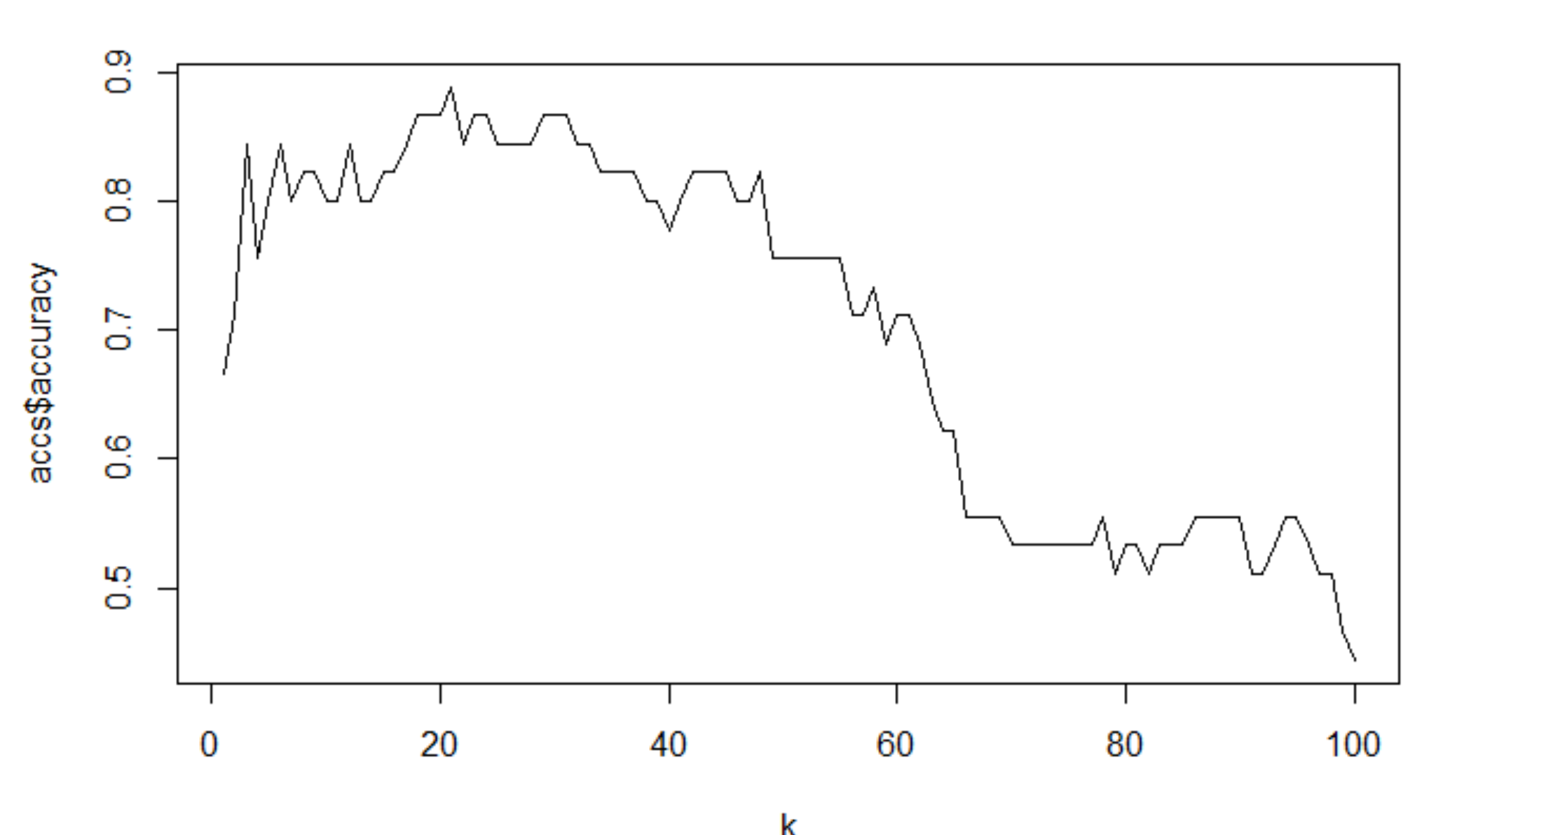
Question 2

Slide 14
I found the best K was 20. You can see that at that point it never reaches the peak.

Slide 15

Part 3 ($≤1 hour$)
Takeaways
and
questions!

Slide 16
KNN was fun to test out and I found easier to do in R then I did python.

